Slide 1

W99702 Audio Programming
and
Audio Library API
PC30 黃永昌 呂世仁
Email: ychuang3@winbond.com.tw
TEL: +886-5-678168 Ext. 7981

Slide 2
Outline
W99702 audio features
W99702 audio controller register groups
Data transfer
AC-link interface
I2S
ADC and DACs
M80 interface – MA-3/MA-5
M80 interface – W569x
Audio Library API

Slide 3
W99702 Audio Features
External AC97 codec 16-bits PCM 2-channels playback and 2-channels record
External I2 codec 16-bits PCM 2-channels playback and 2-channels record
External Yamaha MA-3 codec 8-bits PCM 2-channels playback
External Yamaha MA-5 codec 16-bits PCM 2-channels playback
External Winbond W5691 codec 16-bits PCM 2-channels playback
One built-in ADC 16-bits PCM single channel record
Two built-in DACs 16-bits PCM 2-channels playback

Slide 4
Register Groups
ACTL_CON
Audio controller enable, PFIFO, RFIFO, TDMA, RDMA, and function blocks enable
ACTL_RESET
Play and record channel select, playback and record trigger of each audio functions (AC97, I2S, M80, AD/DA)
ACTL_RDSTB, ACTL_RDST_LENGTH
Record DMA buffer base address and length
ACTL_PDSTB, ACTL_PDST_LENGTH
Play DMA buffer base address and length
ACTL_PSR, ACTL_RSR
Audio playback status and audio record status

Slide 5
ACTL_IISCON
I2S interface clock setting
ACTL_ACCON
External AC97 codec reset. AC97 codec register read/write status
ACTL_ACOS0, ACTL_ACOS1, ACTL_ACOS2
AC-link interface output slot 0 ~ 2
ACTL_ACIS0, ACTL_ACIS1, ACTL_ACIS2
AC-link interface input slot 0 ~ 2
ACTL_ADCON, ACTL_DACON
AD/DA volume, channel, and sampling rate setting
ACTL_M80CON
M80 interface command control (for MA3/MA5, and W569x)
ACTL_M80DATA0~3, ACTL_M80ADDR, ACTL_SRADDR, ACTL_M80SIZE
M80 interface command parameters (for MA3/MA5, and W569x)

Slide 6
Data Transfer
 | PCM buffer (2 channels)
0x10000 | Left channel – LSB byte
0x10001 | Left channel – MSB byte
0x10002 | Right channel – LSB byte
0x10003 | Right channel – MSB byte
0x10004 | Left channel – LSB byte
0x10005 | Left channel – MSB byte
0x10006 | Right channel – LSB byte
0x10007 | Right channel – MSB byte
… | …
 | PCM buffer (1 channel)
0x10000 | Left channel – LSB byte
0x10001 | Left channel – MSB byte
0x10002 | Left channel – LSB byte
0x10003 | Left channel – MSB byte
0x10004 | Left channel – LSB byte
0x10005 | Left channel – MSB byte
0x10006 | Left channel – LSB byte
0x10007 | Left channel – MSB byte
… | …
PCM Data Format

Slide 7
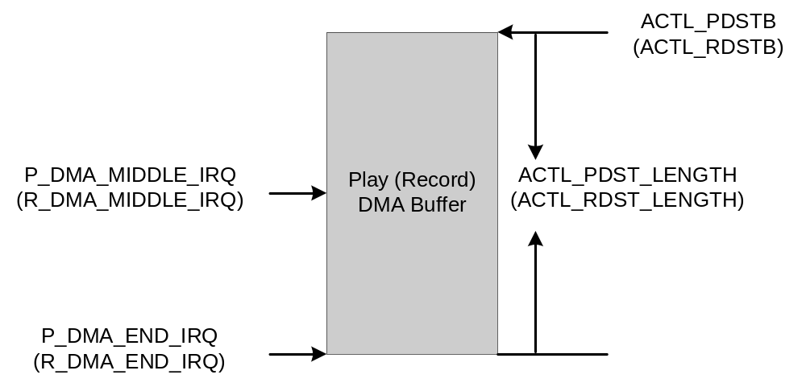
Double Bufferring and IRQ

Slide 8
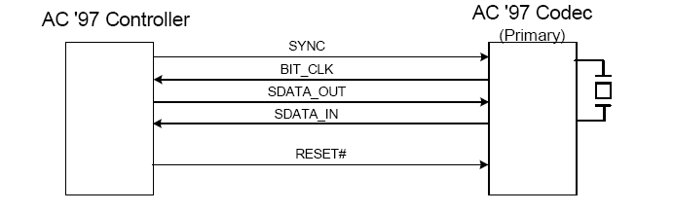
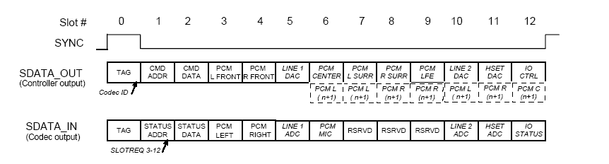
AC-Link Interface

Slide 9
W99702 AC-Link support
Slot # | 0 | 1 | 2 | 3 | 4 | 5 | 6 | 7 | 8 | 9 | 10 | 11 | 12
Content | Tag | CMD ADDR | CMD DATA | PCM LEFT | PCM RIGHT | -- | -- | -- | -- | -- | -- | -- | --
Bits |  | 8 | 16 | 16 | 16
Phase | Tag phase | Data phase
Read/Write external AC97 codec registers
ACTL_ACOS0 (SDATA_OUT) - Tag
ACTL_ACOS1 (SDATA_OUT) - CMD ADDR
ACTL_ACOS2 (SDATA_OUT) - CMD DATA
ACTL_ACOS0 (SDATA_IN) - Tag
ACTL_ACOS1 (SDATA_IN) - STATUS ADDR
ACTL_ACOS2 (SDATA_IN) - STATUS DATA

Slide 10
AC97 Playback/Record Flow
Step | Action | Control Registers
1 | Enable W99702 Audio Controller and select AC-Link interface | ACTL_CON
2 | Cold reset external AC97 codec | ACTL_ACCON
3 | Select play/record channels | ACTL_RESET
4 | Configure external AC97 codec (volume, path, sampling rate) | ACTL_ACIS0~2, ACTL_ACOS0~2
5 | Prepare DMA buffer for playback/record | ACTL_PDSTB, ACTL_PSDT_LENGTH, ACTL_RDSTB, ACTL_RDST_LENGTH
6 | Enable playback/record | ACTL_RESET
7 | Double-Buffering Access in ISR (Determine first half or second half by x_DMA_MIDDLE_IRQ, x_DMA_END_IRQ | ACTL_PSR, ACTL_RSR
8 | Stop playback/record | ACTL_RESET

Slide 11
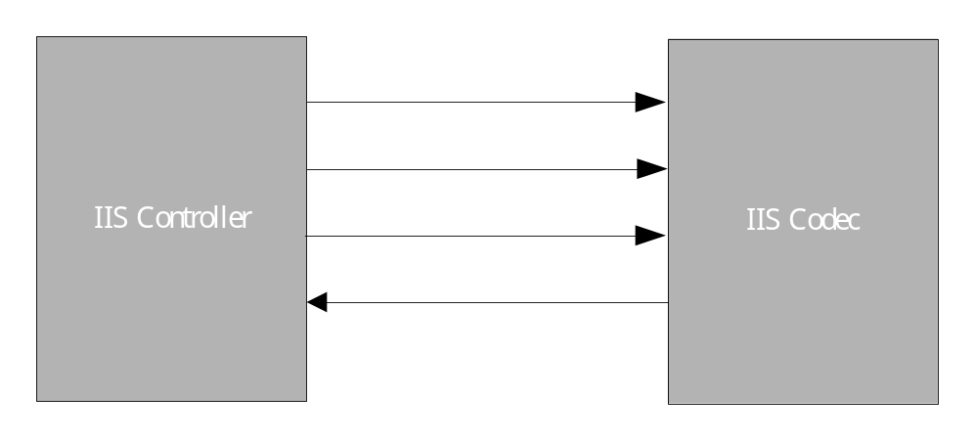
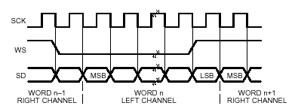
I2S Interface

Slide 12
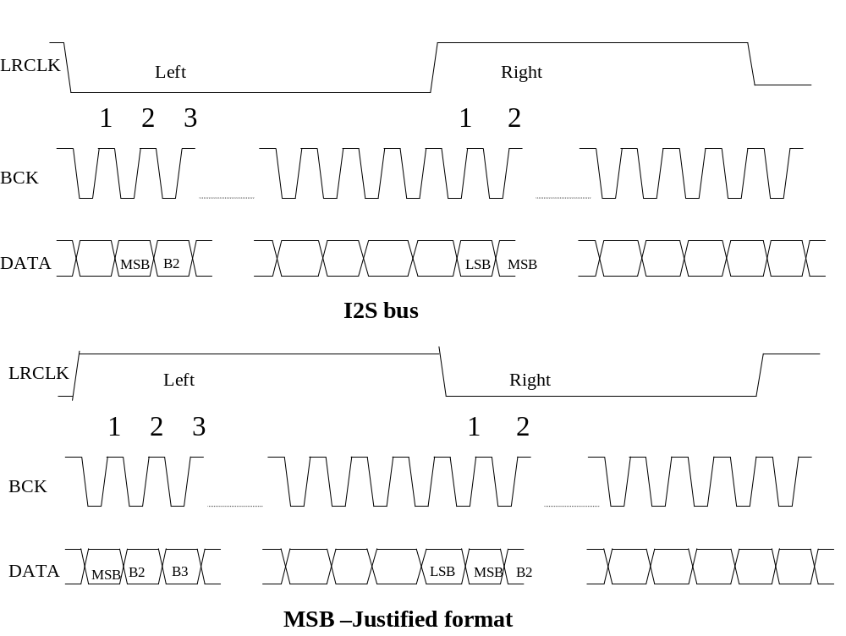
W99702 IIS support
MCLK
BCLK
Audio
Controller
LRCLK
Audio
Codec
DOUT
DIN

Slide 13
IIS Playback/Record Flow
Step | Action | Control Registers
1 | Enable W99702 Audio Controller and select IIS interface | ACTL_CON
2 | Reset audio interface and IIS interface | ACTL_RESET
3 | Configure external I2S codec (volume, codec power up, no mute, no de-emphasize, sampling rate and data format) through L3 interface.
4 | Select play/record channels | ACTL_RESET
5 | Set sampling frequency and data format | ACTL_IISCON
6 | Prepare DMA buffer for playback/record | ACTL_PDSTB, ACTL_PSDT_LENGTH, ACTL_RDSTB, ACTL_RDST_LENGTH
7 | Enable playback/record | ACTL_RESET
8 | Double-Buffering Access in ISR (Determine first half or second half by x_DMA_MIDDLE_IRQ, x_DMA_END_IRQ | ACTL_PSR, ACTL_RSR
9 | Stop playback/record | ACTL_RESET

Slide 14
ADC and DACs
31 | 30 | 29 | 28 | 27 | 26 | 25 | 24
 |  |  | DAC1_VOL[4:0]
23 | 22 | 21 | 20 | 19 | 18 | 17 | 16
 |  |  | DAC0_VOL[4:0]
15 | 14 | 13 | 12 | 11 | 10 | 9 | 8
 |  | DAC1_OEB | DAC0_OEB |  | DAC_DEM[2:0]
7 | 6 | 5 | 4 | 3 | 2 | 1 | 0
DAC_SAMPLE[3:0] |  |  |  | DAC_ZCD_EN |  | DAC_MUTE
31 | 30 | 29 | 28 | 27 | 26 | 25 | 24
23 | 22 | 21 | 20 | 19 | 18 | 17 | 16
15 | 14 | 13 | 12 | 11 | 10 | 9 | 8
 |  |  | ADC_VOL[4:0]
7 | 6 | 5 | 4 | 3 | 2 | 1 | 0
ADC_SAMPLE[3:0] |  |  |  | ADC_ZCD_EN |  | ADC_MUTE

Slide 15
DACs/ADC Playback Flow
Step | Action | Control Registers
1 | Enable W99702 Audio Controller and select DAC | ACTL_CON
2 | Select play channels | ACTL_RESET
3 | Configure DACs (channels, volume, sampling rate) | ACTL_DACON
4 | Prepare DMA buffer for playback/record | ACTL_PDSTB, ACTL_PSDT_LENGTH,
5 | Enable DACs playback | ACTL_RESET
6 | Double-Buffering Access in ISR (Determine first half or second half by P_DMA_MIDDLE_IRQ, P_DMA_END_IRQ | ACTL_PSR
7 | Stop DACs playback | ACTL_RESET

Slide 16
ADC Record Flow
Step | Action | Control Registers
1 | Enable W99702 Audio Controller and select ADC | ACTL_CON
2 | Select record channel – single channel | ACTL_RESET
3 | Configure DACs (enable, volume, sampling rate) | ACTL_DACON
4 | Prepare DMA buffer for playback/record | ACTL_RDSTB, ACTL_RDST_LENGTH
5 | Enable ADC record | ACTL_RESET
6 | Double-Buffering Access in ISR (Determine first half or second half by R_DMA_MIDDLE_IRQ, R_DMA_END_IRQ | ACTL_PSR, ACTL_RSR
7 | Stop playback/record | ACTL_RESET

Slide 17
M80 Interface – MA-3/MA-5/W5691
M80 interface can support Yamaha MA-3/MA-5 and Winbond W569x series melody chips
Support software control mode – software can fully control M80 interface
MA-3 – 8-bits PCM 2-channels playback
MA-5 – 16-bits PCM 2-channels playback
W5691 – 16-bits PCM 1-channels playback
W99702 audio controller supports hardware access to MA-3/MA-3/w5691 interface registers, intermediate registers, control registers, and internal SRAM.

Slide 18
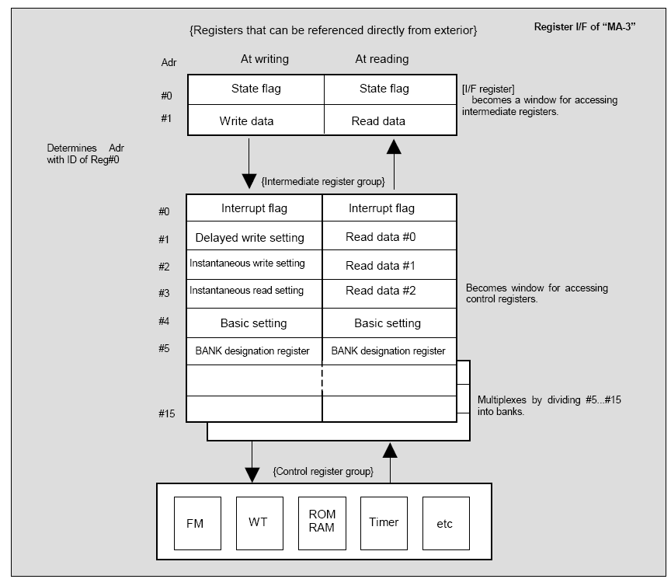
Yamaha MA-3

Slide 19
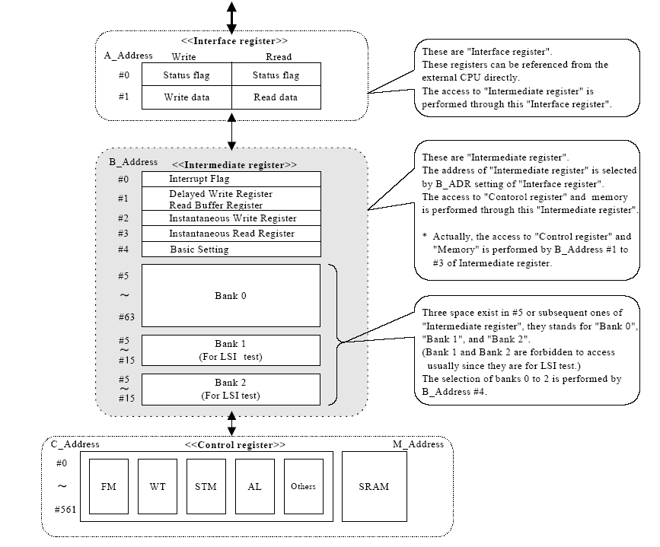
Yamaha MA-5

Slide 20
Winbond W5691
CLKI
PLLC
TEST
/RESET
PVDD
VDD
VSS
SPKVDD
SPKVSS
PLL
Clock
8-bit uP
Generator
65C02S
General
RAM
OP0
/CS
FIFO
Output
OP1
Port
OP2
/RD
Sequencer
Synthe-
ROM
OP3
/WR
CPU
FIFO
sizer
A0
Interface
VREF
D0~D7
Speech
EQL0
FIFO
WTB
DAC
Equalizer
ROM
EQL1
Buffer
Speaker
SPKOUT0
/IRQ
Amp.
SPKOUT1
Timer

Slide 21
Audio Library API
INT audioSelectDevice(AU_DEV_E ePlayDev, AU_DEV_E eRecDev);
VOID audioSetRecBuff(UINT32 uRecBuffAddr, UINT32 uRecBuffSize);
INT audioStartRecord(AU_CB_FUNC_T fnCallBack, INT nSamplingRate, INT nChannel);
VOID audioStopRecord(VOID);
VOID audioSetPlayBuff(UINT32 uPlayBuffAddr, UINT32 uPlayBuffSize);
INT audioStartPlay(AU_CB_FUNC_T fnCallBack, INT nSamplingRate, INT nChannel);
VOID audioStopPlay(VOID);
INT audioSetPlayVolume(UINT8 ucLeftVol, UINT8 ucRightVol);
INT audioSetRecordVolume(UINT8 ucLeftVol, UINT8 ucRightVol);

Slide 22
Playback Flow
Call audioSelectDevice() to select a playback device
Prepare playback buffer and call audioSetPlayBuff() to announce it
Prepare callback function
INT play_callback(UINT8 *pucPcmBuff, UINT32 uDataLen);
Call audioStartPlay() to start playback
Call audioStopPlay() to stop playback
Record Flow
Call audioSelectDevice() to select a record device
Prepare playback buffer and call audioSetRecordBuff() to announce it
Prepare callback function
INT rec_callback(UINT8 *pucPcmBuff, UINT32 uDataLen);
Call audioStartRecord() to start recording
Call audioStopRecord() to stop recording

